Slide 1
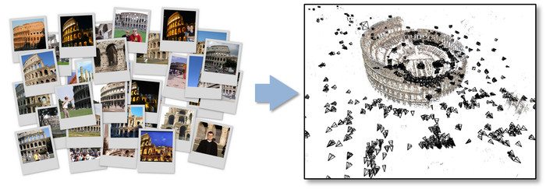
Structure-from-Motion (SfM)
TA: Sanghyun Woo
shwoo93@kaist.ac.kr

Slide 2
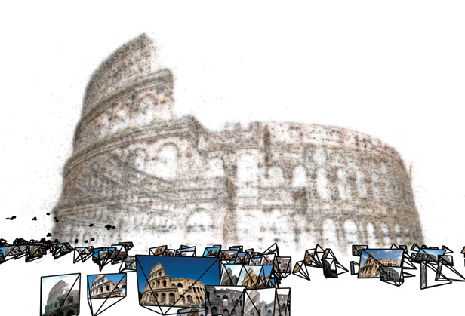
What is SfM?
Structure from Motion (SfM)
The process of estimating three-dimensional structures from two-dimensional image sequences which may be coupled with local motion signals.
Input
Freely taken images with overlapped scenery
Output
camera pose and 3D structure of the scene
Implementation issues
Feature extraction and matching
Camera motion(pose) estimation
Outlier removal using RANSAC
3D Reconstruction using triangulation
LM-based non-linear optimization
Reference
http://photosynth.net
N.Snavely et al., “Photo Tourism: Exploring
photo collections in 3D”, SIGGRAPH 2006

Slide 3
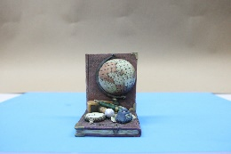
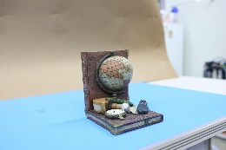
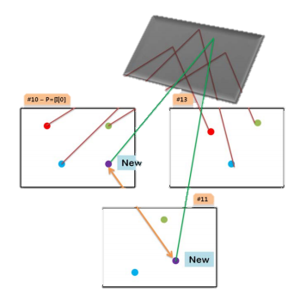
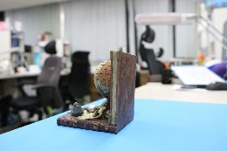
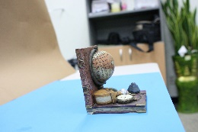

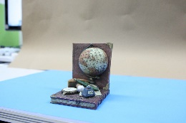
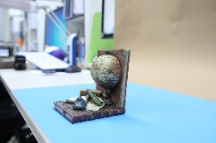
Overall Strategy
A set of images
Feature Extraction
& Matching
(Two-view)
Initialization Step
( > Three-view)
Growing Step
[2] Hartley, Richard, and Andrew Zisserman. Multiple view geometry in computer vision. Cambridge university press, 2003.
[3] Szeliski, Richard. Computer vision: algorithms and applications. Springer Science & Business Media, 2010.

Slide 4
Overall Strategy
Given a set of images,
Correspondence search, Relating images
1. Extract SIFT from every image and find putative matches
2. Outliers should be rejected by applying RANSAC
Initialization Step
3. Find the best image pair(simply, has the maximum matches or take the base-line into account)
4. Estimate motion(R and t) and Reconstruct 3D points for the selected image pair. The camera coordinate of one camera is used for the world coordinate.
Growing Step
5. Search images which have enough points seeing the reconstructed 3D point
6. Compute pose(R and t) for those images and reconstruct more 3D points seen from more than two images
Bundle Optimization
Repeat the Growing step until every camera is included.

Slide 5
1. Feature extraction & matching

Slide 6
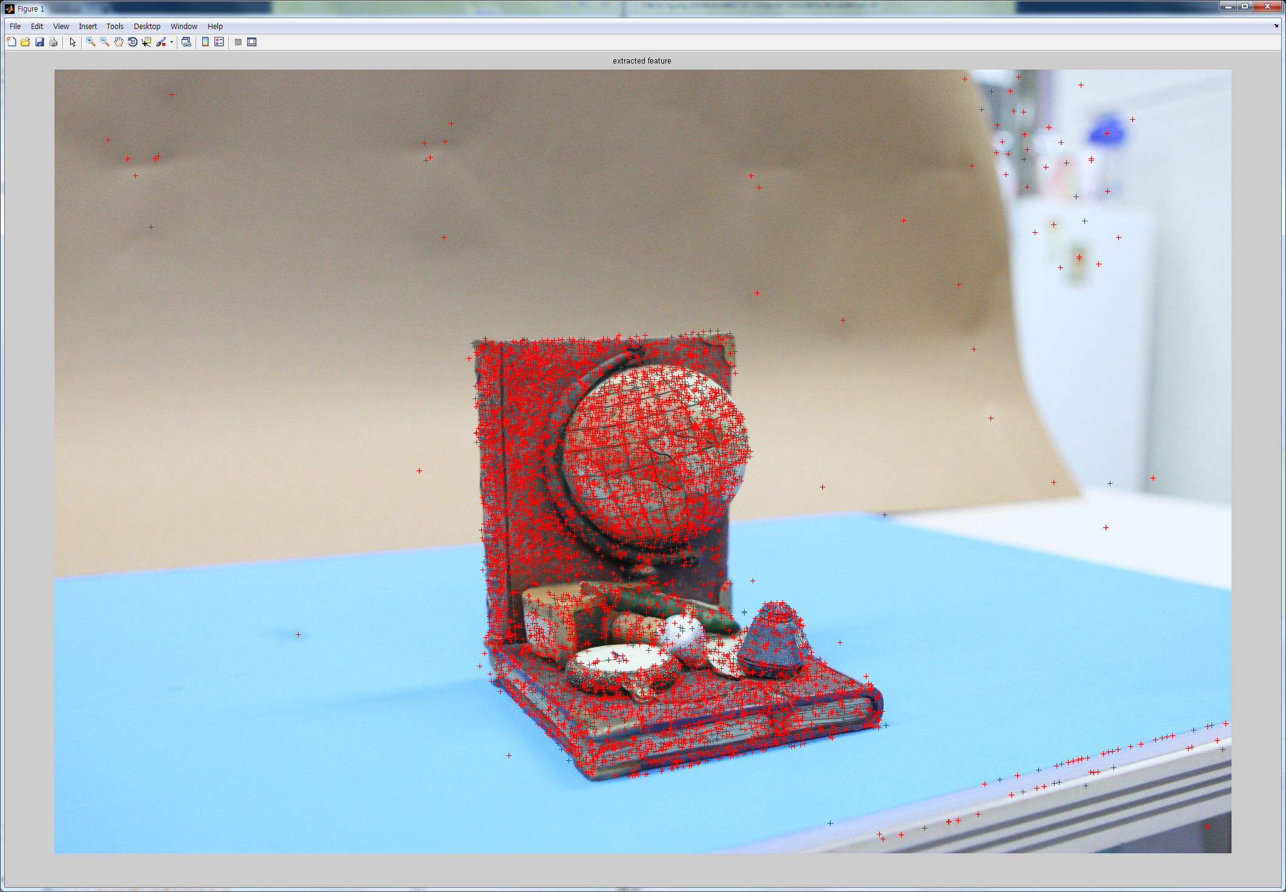
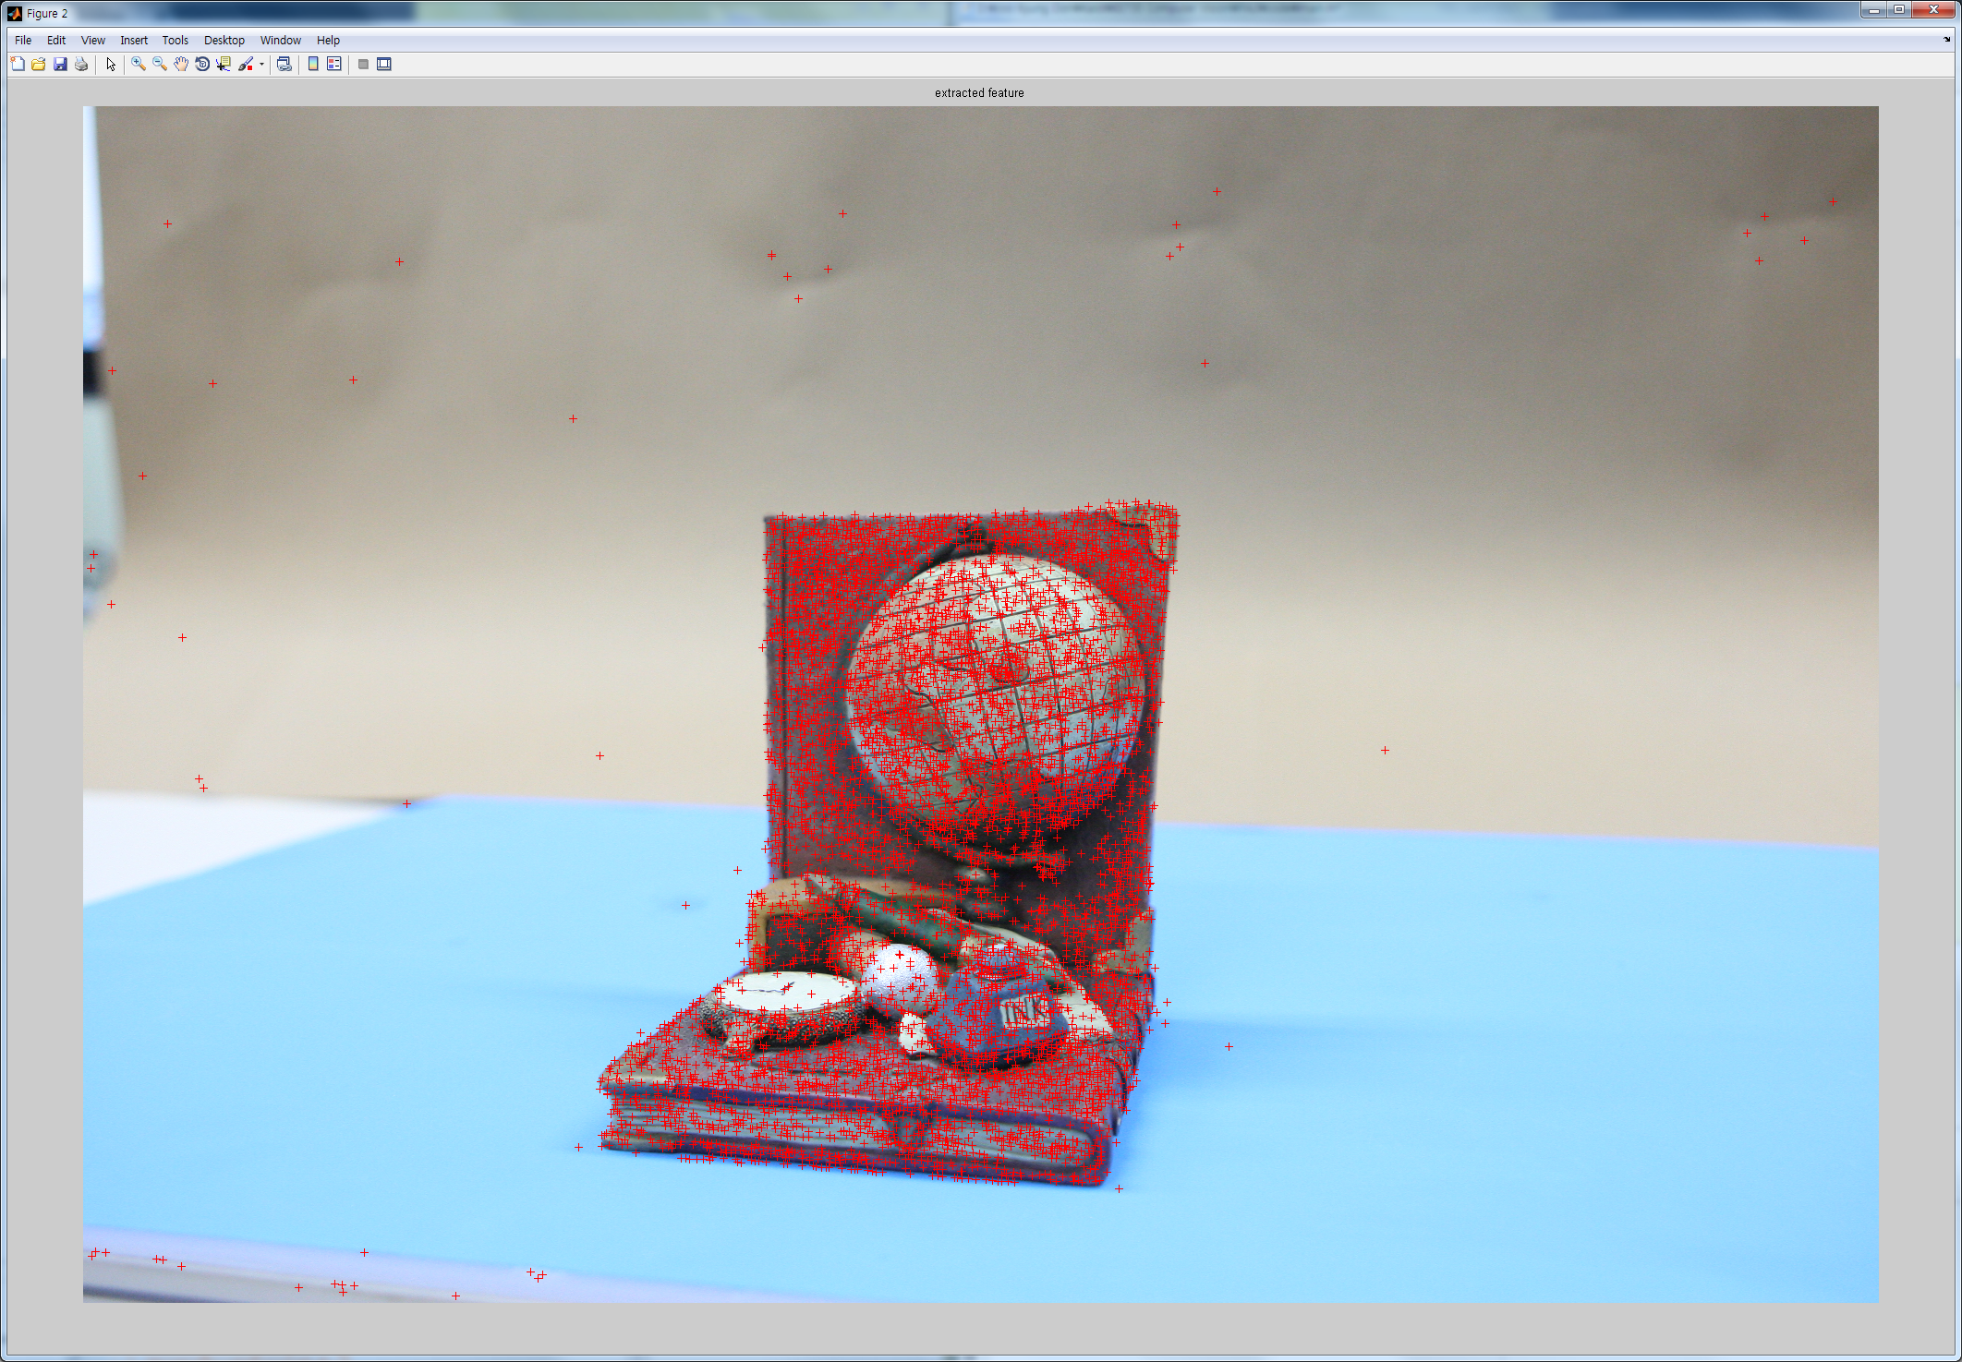
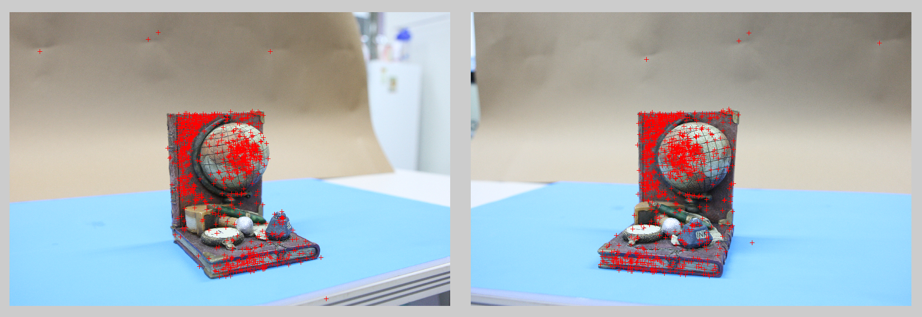
Feature extraction & matching
[4] Lowe, David G. "Distinctive image features from scale-invariant keypoints."International journal of computer vision 60.2 (2004): 91-110.
SIFT (Scale Invariant Feature Transform)
Use the functions ‘vl_sift’, ‘vl_ubcmatch’
Website : http://www.vlfeat.org
Feature Matching
Feature Extraction
6
A set of images
Feature Extraction
& Matching
Initialization Step
Growing Step

Slide 7
2. Initialization step

Slide 8
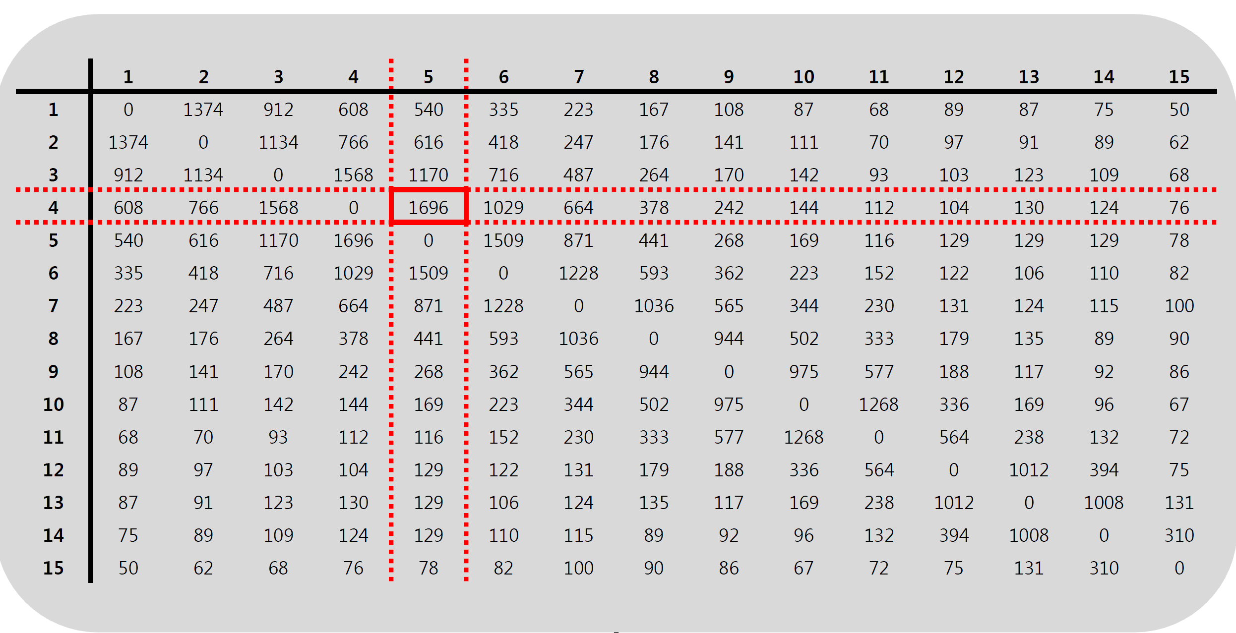
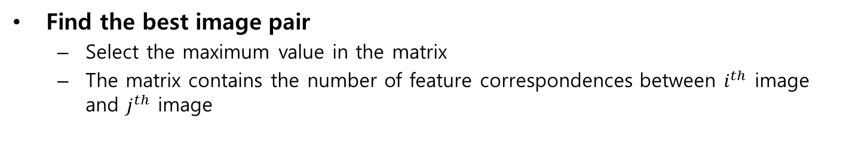
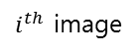
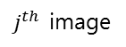
Initialization step
Find the best image pair
Select the maximum value in the matrix
The matrix contains the number of feature correspondences between $i^{th}$ image and $j^{th}$ image
$j^{th}$ image
Ex)
Reference
: 4th image
Pair
: 3rd image
Maximum matching points pair
$i^{th}$ image
A set of images
Feature Extraction
& Matching
Initialization Step
Growing Step
Find the best image pair
8, 7-pt algorithm (F)
Triangulation
Calibrated, 5-pt algorithm (E)

Slide 9
Initialization step
[5] Nistér, David. "An efficient solution to the five-point relative pose problem.“ TPAMI 2004
Estimate Essential matrix ‘E’ given a set of match points {x, x’}
Use the functions ‘calibrated_fivepoint’
Tip
5-point algorithm needs only 5 feature correspondences.
Randomly select 5 points repeatedly
Find the best essential matrix ‘E’ by counting the number of inliers
This calls RANSAC
A set of images
Feature Extraction
& Matching
Initialization Step
Growing Step
Estimate Motion
Find the best image pair
8, 7-pt algorithm (F)
Triangulation
Calibrated, 5-pt algorithm (E)

Slide 10
Initialization step
[5] Nistér, David. "An efficient solution to the five-point relative pose problem.“ TPAMI 2004
RANSAC – RANdom SAmple Consensus (Toy example)
Model: line – require 2 points samples
1. Randomly select sets of 2 points
2. Generate line(hypothesis) and evaluate using other points with pre-defined threshold
3. Do this for many times and choose the most supportive hypothesis having the most inliers
2 points
threshold
3 points
6 points
2 points

Slide 11
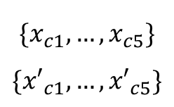
Initialization step
[2] Hartley, Richard, and Andrew Zisserman. Multiple view geometry in computer vision. Cambridge university press, 2003.
RANSAC – RANdom SAmple Consensus (For our case)
Model: ‘E’– require 5 points samples
1. Randomly select sets of 5 points
2. Generate E(hypothesis) and evaluate using other points with pre-defined threshold - epipolar distance (see next page)
3. Do this for many times and choose the most supportive hypothesis having the most inliers
Randomly Selected correspondence
$$\{x_{c1}, …,x_{c5}\}$$
$$\{{x′}_{c1}, …,{x′}_{c5}\}$$
E using calibrated
5-pt algorithm

Slide 12
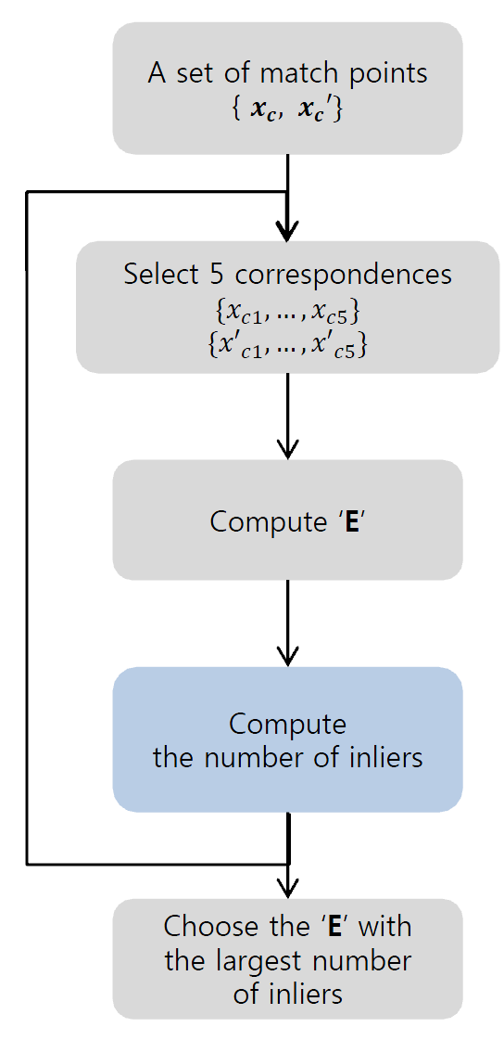
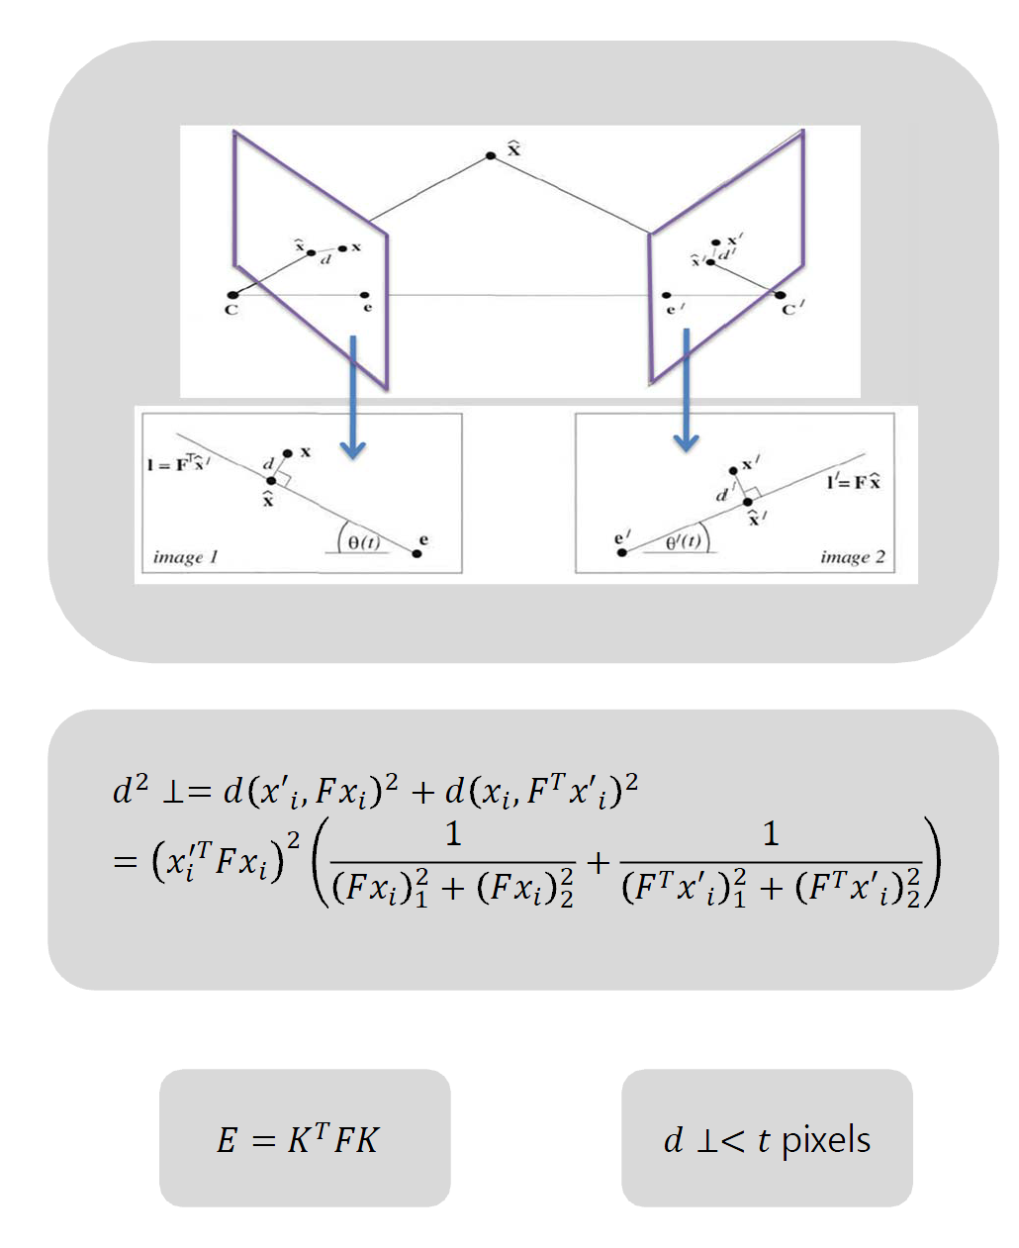
Initialization step
[2] Hartley, Richard, and Andrew Zisserman. Multiple view geometry in computer vision. Cambridge university press, 2003.
Epipolar distance
Compute the number of inliers
Choose the best E with the largest number of inliers

Slide 13
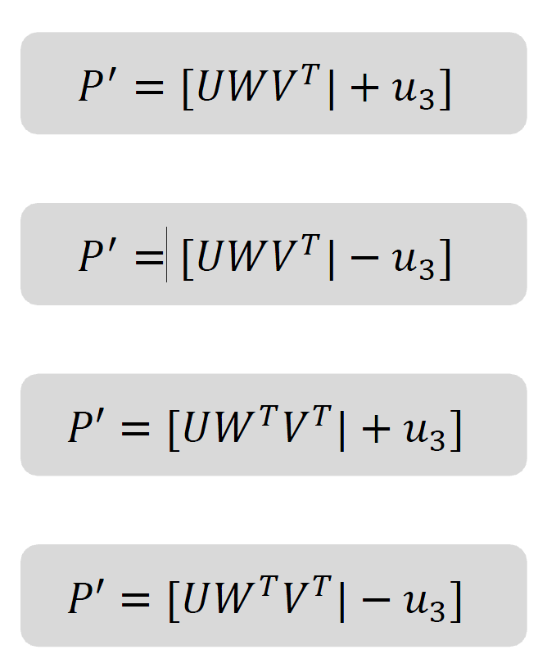
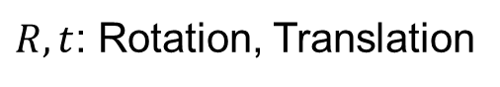
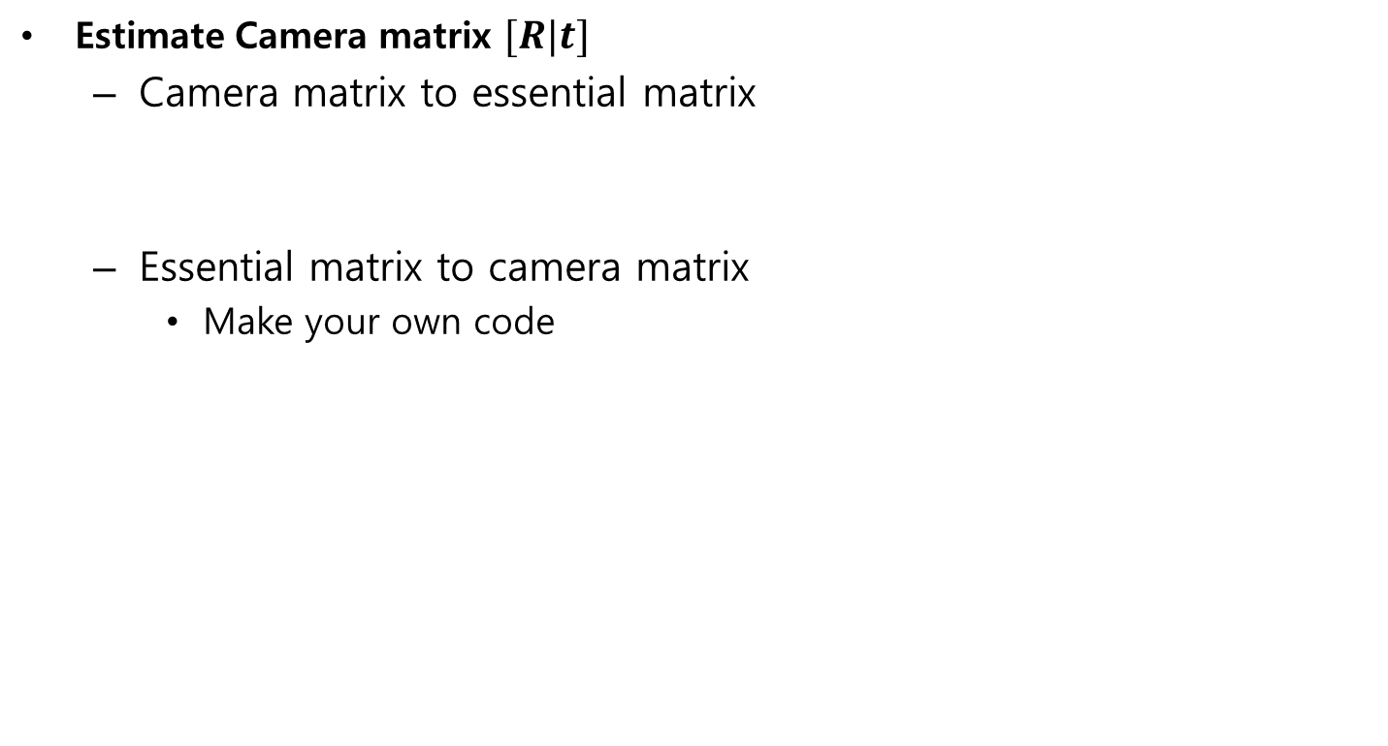
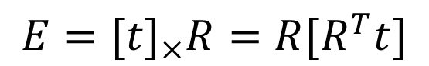
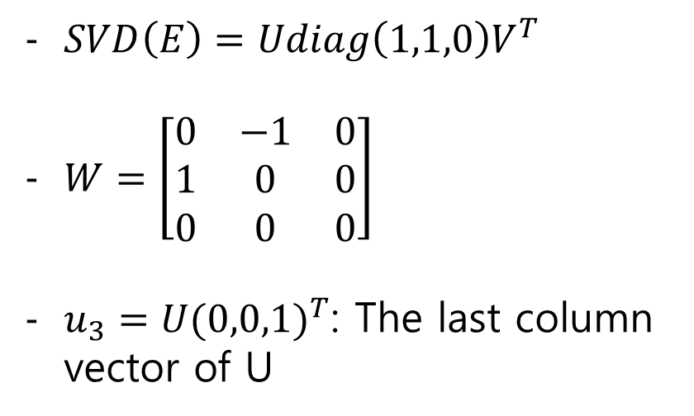
Initialization step
MVG 9.6 (p.257-p.260)
6.2.3 (p.162)
Estimate Camera matrix $[R|t]$
Camera matrix to essential matrix
Essential matrix to camera matrix
Make your own code
$$E=[t]_{×}R=R[R^{T}t]$$
$R,t$: Rotation, Translation
$SVD\left(E\right)=Udiag\left(1,1,0\right)V^{T}$
$W=\left[\begin{matrix}0 & −1 & 0 \\ 1 & 0 & 0 \\ 0 & 0 & 0\end{matrix}\right]$
$u_{3}=U{(0,0,1)}^{T}$: The last column vector of U

Slide 14
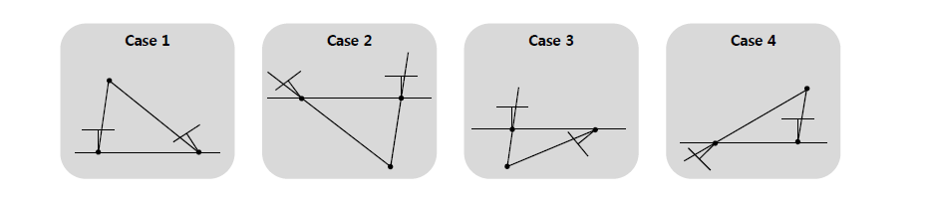
Initialization step
MVG 9.6 (p.257-p.260)
6.2.3 (p.162)
Essential matrix to Camera matrix
There are four possible reconstruction
Depth for both camera should be positive value (case 1)
Not negative value (case 2, 3, 4)
You should figure out the optimal camera pose

Slide 15
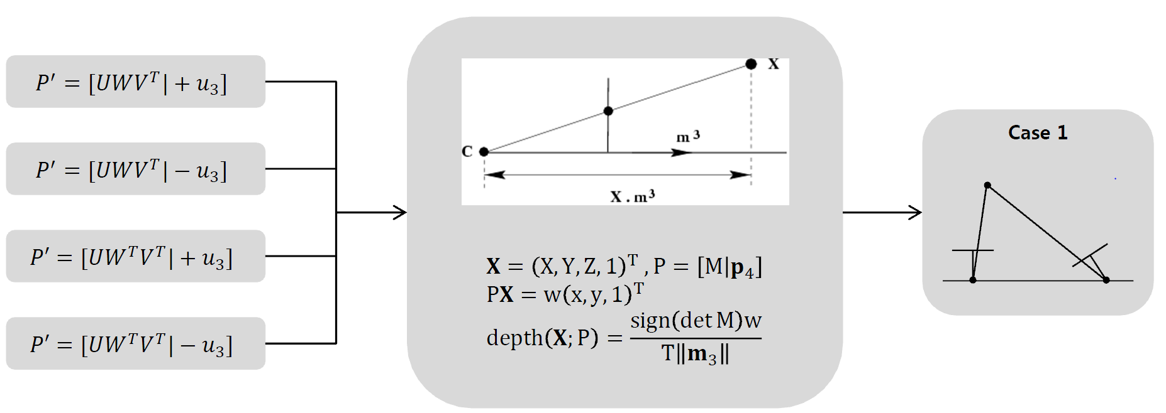
Initialization step
MVG 9.6 (p.257-p.260)
6.2.3 (p.162)
Essential matrix to Camera matrix
There are four possible reconstruction
Depth for both camera should be positive value (case 1)
Not negative value (case 2, 3, 4)
You should figure out the optimal camera pose

Slide 16
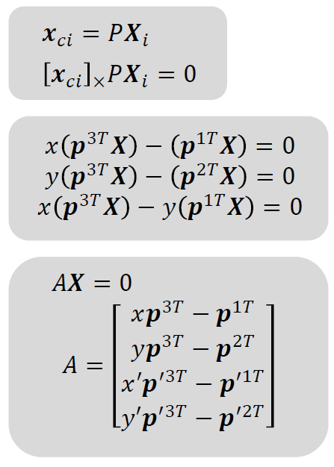
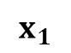
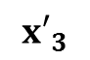
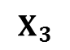
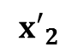
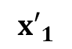
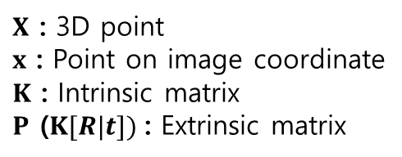
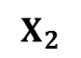
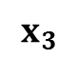
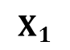
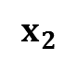
Initialization step
$X$ : 3D point
$x$ : Point on image coordinate
$K$ : Intrinsic matrix
$P$ ($K[R|t])$: Extrinsic matrix
Triangulation
3D reconstruction with P=[R|t]
$$X_{2}$$
$$X_{1}$$
$$X_{3}$$
$${x′}_{2}$$
$$x_{2}$$
$${x′}_{1}$$
$${x′}_{3}$$
$$x_{1}$$
$$x_{3}$$
Cam2
Cam1
A set of images
Feature Extraction
& Matching
Initialization Step
Growing Step
Find the best image pair
8, 7-pt algorithm (F)
Triangulation
Calibrated, 5-pt algorithm (E)

Slide 17
3. Growing step

Slide 18
Growing step
[8] Haralick, Bert M., et al. "Review and analysis of solutions of the three point perspective pose estimation problem." IJCV (1994)
Estimate Camera matrix ‘P’ given a set of match points and 3D {x, X}
Use the functions ‘PerspectiveThreePoint’
Tip
3-point algorithm needs only 3 feature correspondences.
Randomly select 3 points repeatedly
Find the best camera matrix ‘P’ by counting the number of inliers
This calls RANSAC
A set of images
Feature Extraction
& Matching
Initialization Step
Growing Step
Estimate Motion
Find the best image pair
6-pt DLT algorithm
Triangulation
3-pt algorithm

Slide 19
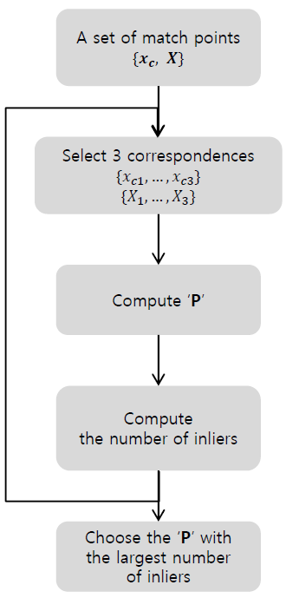
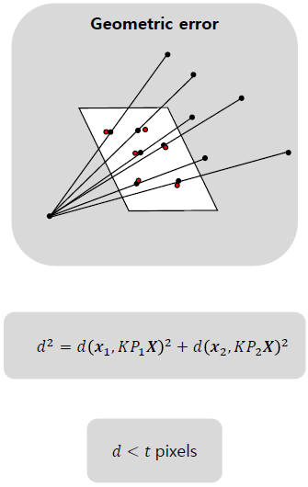
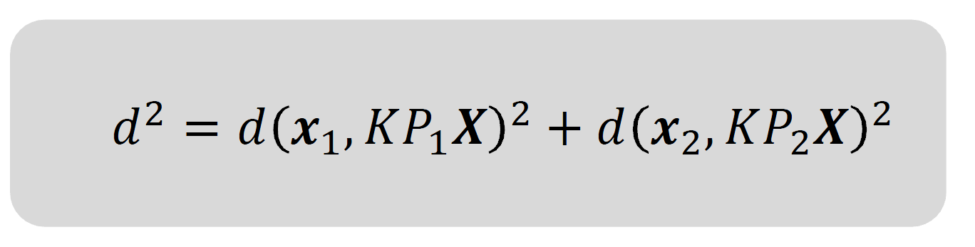
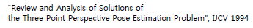
Growing step
[2] Hartley, Richard, and Andrew Zisserman. Multiple view geometry in computer vision. Cambridge university press, 2003.
Geometric error
Compute the number of inliers
Choose the best P with the largest number of inliers

Slide 20
Growing step
$X$ : 3D point
$x$ : Point on image coordinate
$K$ : Intrinsic matrix
$P$ ($K[R|t])$: Extrinsic matrix
Triangulation
3D reconstruction with P=[R|t]
Same as P. 16
$$X_{2}$$
$$X_{1}$$
$$X_{3}$$
$${x′}_{2}$$
$$x_{2}$$
$${x′}_{1}$$
$${x′}_{3}$$
$$x_{1}$$
$$x_{3}$$
Cam2
Cam1
A set of images
Feature Extraction
& Matching
Initialization Step
Growing Step
Find the best image pair
8, 7-pt algorithm (F)
Triangulation
Calibrated, 5-pt algorithm (E)

Slide 21
4. Optimization (Extra credit)

Slide 22
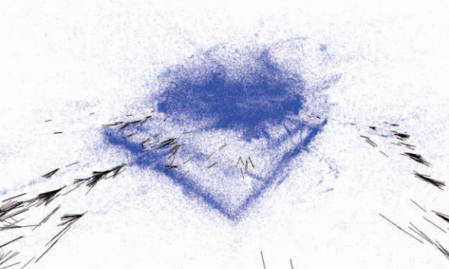
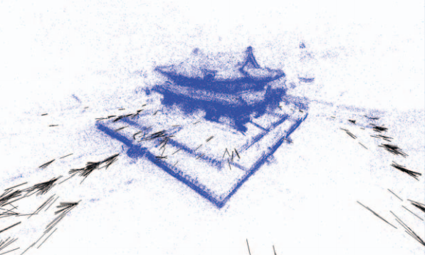
Optimization
Bundle adjustment
Refines a visual reconstruction to produce jointly optimal 3D structure and viewing parameters
‘Bundle’ refers to the bundle of light rays leaving each 3D feature and converging on each camera center.
Before Bundle adjustment
After Bundle adjustment
[6] Triggs, Bill, et al. "Bundle adjustment—a modern synthesis." International workshop on vision algorithms. Springer Berlin Heidelberg, 1999.
[7] Jeong, Yekeun, et al. "Pushing the envelope of modern methods for bundle adjustment."
IEEE transactions on pattern analysis and machine intelligence (2012): 1605-1617.

Slide 23
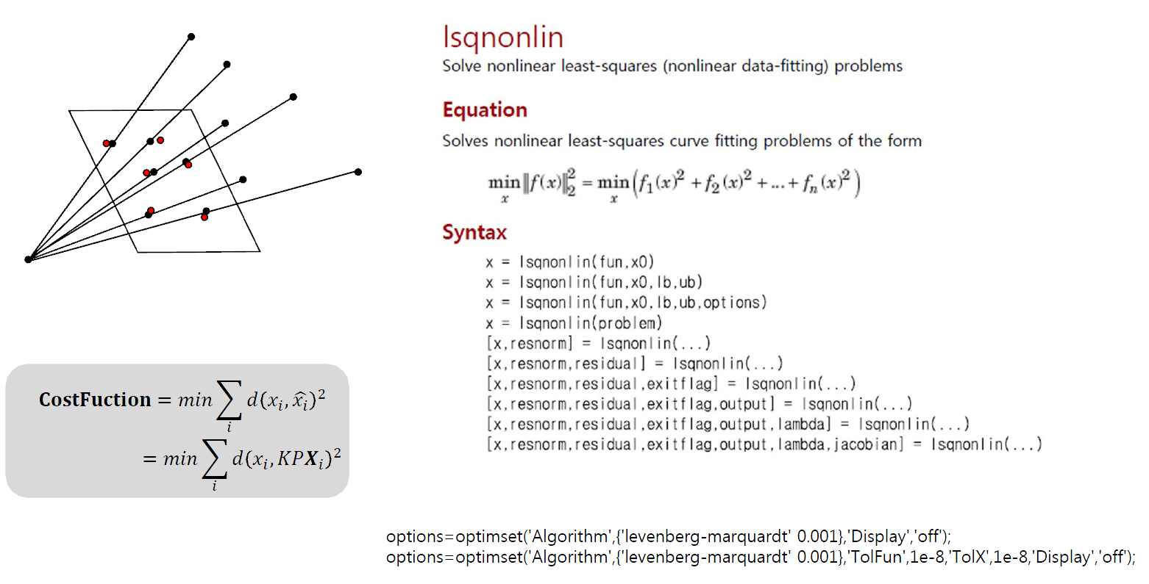
Optimization
LM Optimization
Make your own cost function (fun)
Optimize the function with ‘lsqnonlin’ function
See the error(residual) is decreasing
3D points and camera poses might be barely moved

Slide 24
Optimization
Ceres solver (More extra credit)
An open source C++ library for modeling and solving large, complicated optimization problems.
Code on C++, then use .exe file on MATLAB
Use system function. ex) system(‘ceres.exe video.mp4’);
http://ceres-solver.org/
Dependencies
Eigen
Google Log

Slide 25
5. SfM with Your Own dataset

Slide 26
SfM with Your Own Dataset
To help students understanding what the camera parameters(intrinsic and extrinsic) mean
Camera Calibration using Tool Box
MATLAB Library
http://www.vision.caltech.edu/bouguetj/calib_doc/index.html
C Library
http://docs.opencv.org/doc/tutorials/calib3d/camera_calibration/camera_calibration.html
Tips for making your own dataset
1) Use a fixed-focus camera.
2) Do calibration for camera parameter estimation using toolbox (to get intrinsic).
3) Take pictures of your target scene with the camera of which the intrinsic parameter is known now.
4) Run your SfM program with your dataset by replacing the images and the camera intrinsic matrix K to yours.
5) Explain the way how you do it and show the results on the report.

Slide 27
Additional Information
To simplify the problem ( for given dataset )
We bail the self-calibration part out
All images are captured by one known camera (camera intrinsic matrix K will be provided in a txt file)
A fancy visualization is not necessary
Like traveling images or traversing the whole reconstruction
Visualizing cameras and points are enough
You can choose between MATLAB (easy & recommended), OpenGL, and VRML
You have to do:
SfM with given dataset (each block of SfM)
SfM with your own dataset (including camera calibration)

Slide 28
Auxiliary References
Phillp Torr’s Structure from Motion toolkit
Includes F-matrix estimation, RANSAC, Triangulation and etc.
http://cms.brookes.ac.uk/staff/PhilipTorr/
Noah Snavely’s Bundler
The implementation of ‘Photo Tourism’ paper, which is exactly same as our goal
http://phototour.cs.washington.edu/bundler/
OpenCV
You could find more through Googling

Slide 29
Book Reference
Multiple-View Geometry (HZ)
Basic Projective Geometry (ch. 2,3)
Camera Models and Calibration (ch. 6,8)
Epipolar Geometry and Implementation (ch. 9, 11)
Triangulation (ch. 12)
Computer Vision: Algorithms and Applications (S)
Structure from Motion (ch. 7)

Slide 30
Submission
Due : November 8 11:59PM (No delay)
To : Sanghyun Woo (shwoo93@kaist.ac.kr)
Submission should include…
Report
Source code
Summarization of 3point and 5point algorithm (up to 2page)
Refer to following papers
Readme file explaining how to execute the program
Report should include…
Your understanding of each steps of algorithms
Indication of the parts that you implemented on your own and the parts you used open source code
The origin of the source code if you have used any
Nistér, David. "An efficient solution to the five-point relative pose problem.“ TPAMI 2004
Haralick, Bert M., et al. "Review and analysis of solutions of the three point perspective pose estimation problem." IJCV (1994)

Slide 31
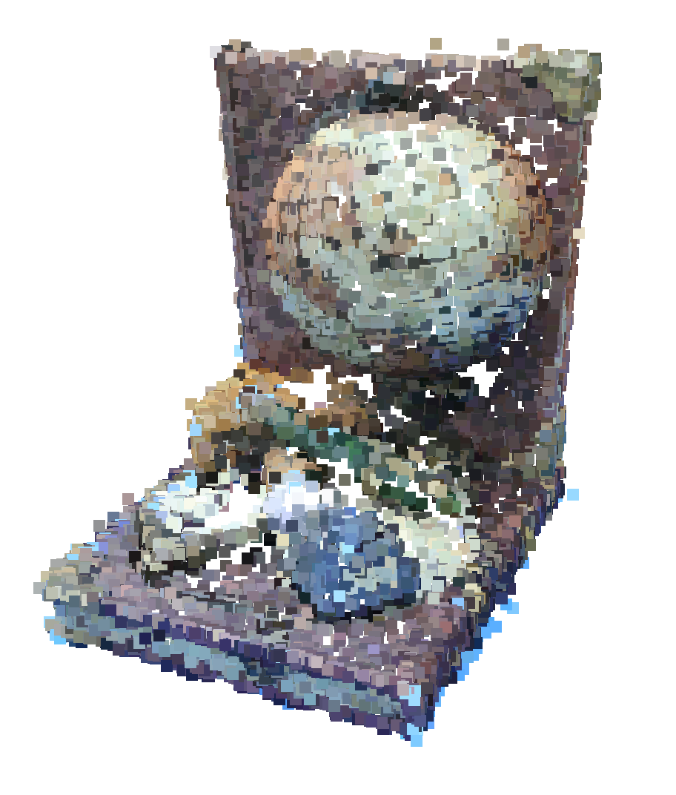
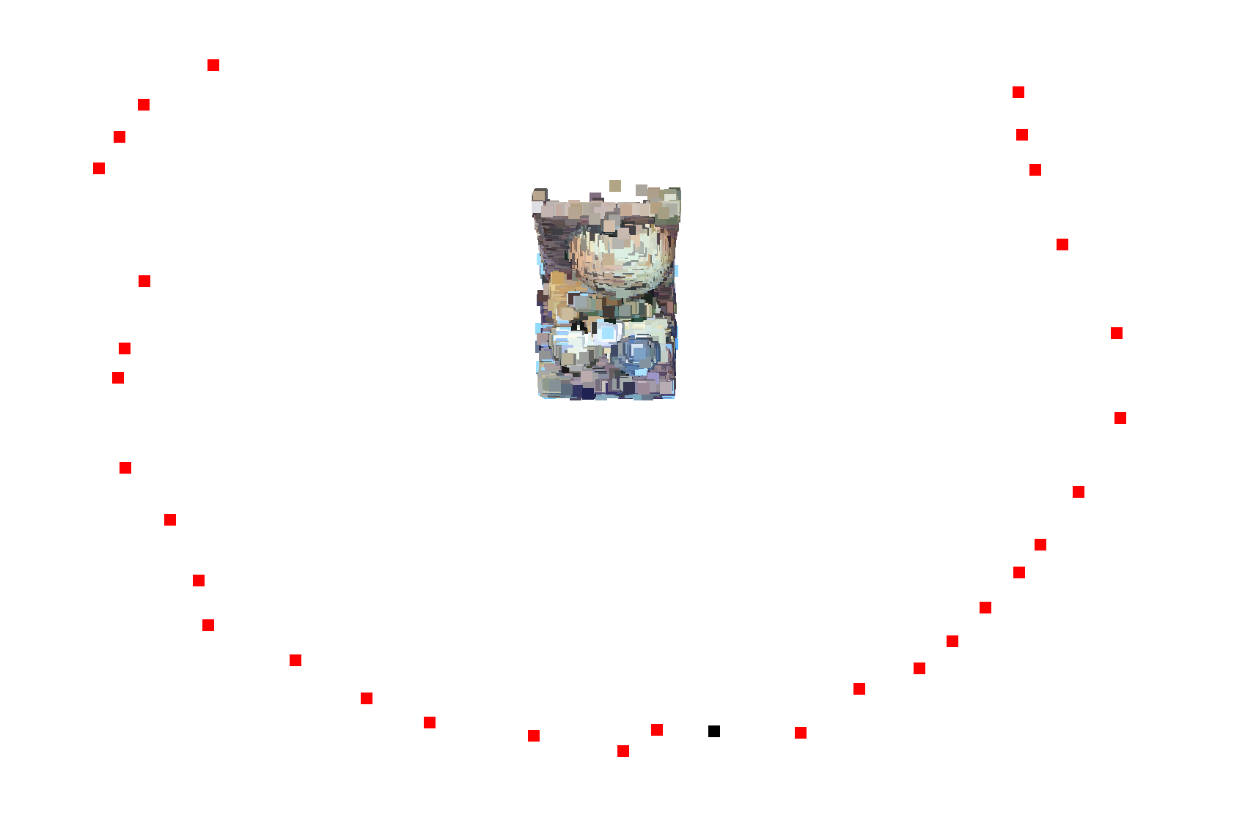
Structure-from-motion
Make 3D with your photos
Camera positions (Red dot)
3D structure

Slide 32
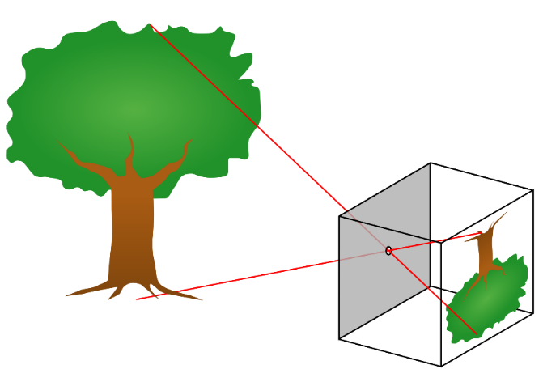
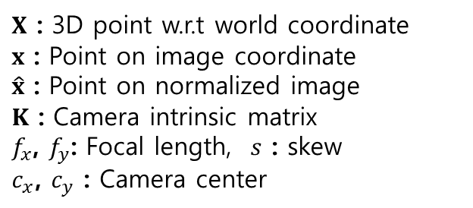





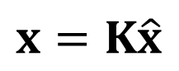

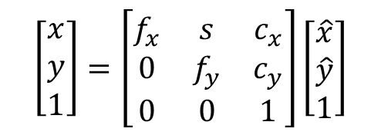




Appendix1: Coordinate System
Perspective projection
(Pinhole model)
Pin-hole camera model
$$X$$
영상 좌표계
Image coordinate
$$x$$
$$y$$
$$x$$
$X$ : 3D point w.r.t world coordinate
$x$ : Point on image coordinate
$\hat{x}$ : Point on normalized image
$K$ : Camera intrinsic matrix
$f_{x}$, $f_{y}$: Focal length, $s$ : skew
$c_{x}$, $c_{y}$ : Camera center
정규 영상 좌표계
Normalized image coordinate
$$\hat{x}$$
$$\hat{x}$$
$$\hat{y}$$
카메라 좌표계
Camera coordinate
$$x=K\hat{x}$$
$$Z$$
표준 좌표계
World coordinate
$$\left[\begin{matrix}x \\ y \\ 1\end{matrix}\right]=\left[\begin{matrix}f_{x} & s & c_{x} \\ 0 & f_{y} & c_{y} \\ 0 & 0 & 1\end{matrix}\right]\left[\begin{matrix}\hat{x} \\ \hat{y} \\ 1\end{matrix}\right]$$
$$X$$
$$Y$$

Slide 33

Appendix2: Epipolar geometry
[2] Hartley, Richard, and Andrew Zisserman. Multiple view geometry in computer vision. Cambridge university press, 2003.
Fundamental matrix $F$
Image 1
Image 2
epipolar plane
epipolar line for
epipolar line for
camera1
center
camera2
center
Epipolar Lines
: camera centers,
: (camera) baseline
: epipolar plane,
: epipoles
Fundamental matrix
: epipolar lines for and respectively
where,
: point on image plane

Slide 34

Appendix2: Epipolar geometry
[5] Nistér, David. "An efficient solution to the five-point relative pose problem.“ TPAMI 2004
Fundamental matrix $F$ estimation
Un-calibrated (Unknown camera intrinsic $K$)
Normalized 8-pts algorithm
7-pts algorithm
Calibrated (Known camera intrinsic $K$)
Estimate $E$ using 5-pts algorithm [7]
Calculate $F$
Essential matrix: The specialization of the fundamental matrix to the case of normalized image coordinates
where,
where,

Slide 35








Appendix3: Camera extrinsic matrix
[2] Hartley, Richard, and Andrew Zisserman. Multiple view geometry in computer vision. Cambridge university press, 2003.
Fundamental matrix $F$ estimation
$π\left(∙\right):$ The projection function
[x,y,1] = [X, Y, Z]/Z
($ℛ^{3}→ℛ^{2}$)
$$\text{X}$$
$${\text{x}}_{2}\text{=}π({\text{P}}_{2}\text{X}\text{)}$$
$${\text{x}}_{1}\text{=}π({\text{P}}_{1}\text{X}\text{)}$$
$${\text{x}}_{2}$$
$${\text{x}}_{1}$$
Camera2
center
Camera1
center
$$\text{P}=\left[\begin{matrix}{\text{P}}_{2} \\ m\end{matrix}\right]{\left[\begin{matrix}{\text{P}}_{1} \\ m\end{matrix}\right]}^{−1}$$

Slide 36


Appendix4: 3-point algorithm
[8] Haralick, Bert M., et al. "Review and analysis of solutions of the three point perspective pose estimation problem." IJCV (1994)
3-point algorithm
$${s_{2}}^{2}+{s_{3}}^{2}−2s_{2}s_{3}cosα=a^{2}$$
$${s_{1}}^{2}+{s_{3}}^{2}−2s_{1}s_{3}cosβ=b^{2}$$
$${s_{1}}^{2}+{s_{2}}^{2}−2s_{1}s_{2}cosγ=c^{2}$$

Slide 37







Appendix5: Bundle Adjustment
Bundle Adjustment’s Mathematical Problem
Minimize re-projection error
Non-linear Least Square approach
Good approximate values are needed
Re-projected point
$$X$$
Objective function
$$π\left(KP_{i}X_{j}\right)$$
$$C\left(P,X\right)=\sum_{i=1}^{n}{\sum_{j=1}^{m}{w_{ij}∥x_{ij}−π\left(KP_{i}X_{j}\right)∥^{2}}}$$
$$×$$
$$x_{ij}$$
$$P$$
$n$: The number of cameras
$m$: The number of features
$π\left(∙\right):$ The projection function
($ℛ^{3}→ℛ^{2}$)
$w_{ij}$: indicator variable
1 if visible, 0 other wise
Re-projection error
Image plane

Slide 38


Appendix5: Bundle Adjustment
Objective function
$$C\left(R,t,X\right)=\sum_{i=1}^{n}{\sum_{j=1}^{m}{w_{ij}∥x_{ij}−π\left(KP_{i}X_{j}\right)∥^{2}}}$$
Bundle Adjustment’s solution
Levenberg-Marquardt (LM) Algorithm
Most popular algorithm for solving non-linear problems
LM algorithm (Augmented normal equation)
is the Jacobian matrix, defined a matrix containing all first-order partial derivatives
is called damping and
is the damping factor
If error decreases than gets smaller otherwise larger (controls the step of corrections)
For and

